Slide 1
Introduction to Web Services
Working with JAX-WS
Notes:
Add instructor notes here.

Slide 2
Lesson Objectives
Working with JAX-WS
WSDL
SOAP
Creating JAX-WS service
Consuming web service
Notes:
Following contents would be covered:
2.1: Working with JAX-WS
2.1.1: What is WSDL
2.1.2: Structure of WSDL
2.1.3: Generating WSDL
2.1.4: What is SOAP
2.1.5: Structure of SOAP
2.2: Creating JAX-WS service
2.3: Consuming JAX-WS service
Going through the contents of lesson

Slide 3
2.1: Overview Working with JAX - WS
Java API for XML web services (JAX-WS), is a set of APIs for creating web services in XML format
In JAX-WS, a web service operation invocation is represented by an XML-based protocol, such as SOAP. The SOAP specification defines the envelope structure, encoding rules, and conventions for representing web service invocations and responses. These calls and responses are transmitted as SOAP messages (XML files) over HTTP
Although SOAP messages are complex, the JAX-WS API hides this complexity from the application developer. On the server side, the developer specifies the web service operations by defining methods in an interface written in the Java programming language.
Notes:
Trainer needs to describe in brief about JAX - WS.
It can be supported by some real-world examples to ease understanding

Slide 4
2.1.1: WSDL What is WSDL ?
WSDL stands for Web Services Description Language
WSDL is a document written in XML. This document describes a Web service. It specifies the location of the service and the operations (or the methods) the service exposes
WSDL documents uses these major elements
<types>
Defines the datatypes (XML Schems) used by the web service
<message>
Defines the data elements for each operation
<portType>
Describes the operations that can be performed and messages involved
<binding>
Defines the protocol and data format for each port type
Notes:
The main structure of WSDL document looks as below:
<definitions> <types> data type definitions........ </types> <message> definition of the data being communicated.... </message> <portType> set of operations...... </portType> <binding> protocol and data format specification.... </binding> </definitions>
This slide describes one of the major components of Web service called WSDL

Slide 5
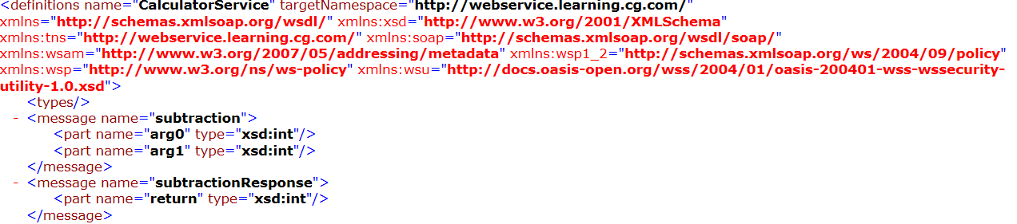
2.1.1: WSDL WSDL Elements
Below is the snap shot of the WSDL file:
Message -> Definition of data being communicated
Notes:
Add the notes here.
Screen shot regarding WSDL -> message element
Demo : JAX – WS – Calculator is shared.
Trainer can use WSDL file generated to explain its different elements

Slide 6
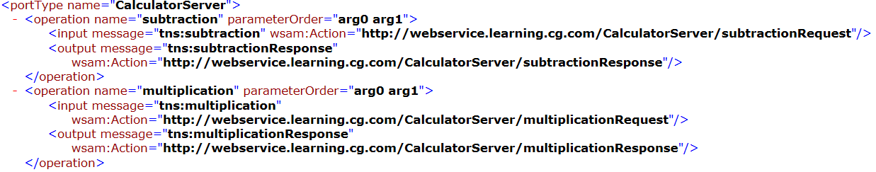
2.1.1: WSDL WSDL Elements
Below is the snap shot of the WSDL file:
Port type-> contains set of operations
Notes:
Add the notes here.
Screen shot regarding WSDL -> port type element
Demo : JAX – WS – Calculator is shared.
Trainer can mention that the namespace is coming from demo shared

Slide 7
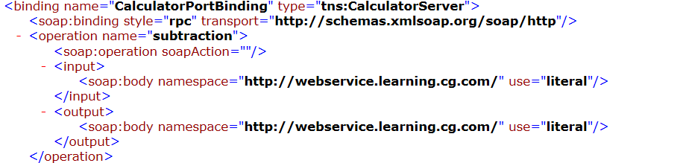
2.1.1: WSDL WSDL Elements
Below is the snap shot of the WSDL file:
Binding->Defines Protocol and data format
Notes:
Add the notes here.
Screen shot regarding WSDL -> Binding element
Demo : JAX – WS – Calculator is shared.
Trainer can reference the WSDL file generated in demo.

Slide 8
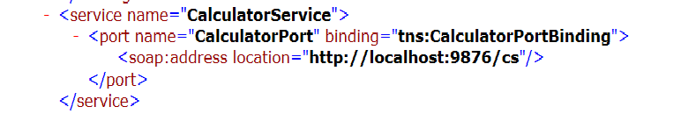
2.1.1: WSDL WSDL Elements
Below is the snap shot of the WSDL file:
Service: Describes the service name to be used , port name and the soap address, where the web service will be available for consumption
Notes:
Add the notes here.
Screen shot regarding WSDL -> service element
Here again the demo code shared can be used as a reference.

Slide 9
2.1.2: SOAP What is SOAP
SOAP is Simple Object Access Protocol
Is a format for sending and receiving messages
It is important for web applications to be able to communicate over the internet
The best way to communicate between applications is over HTTP, because HTTP is supported by all Internet browsers and servers. SOAP was created to accomplish this
SOAP provides a way to communicate between applications running on different operating systems, with different technologies and programming languages
Notes:
SOAP stands for Simple Object Access Protocol
SOAP is an application communication protocol
SOAP is a format for sending and receiving messages
SOAP is platform independent
SOAP is based on XML
SOAP is a W3C recommendation
This slide describes one of the major components of Web service called SOAP

Slide 10
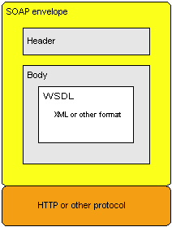
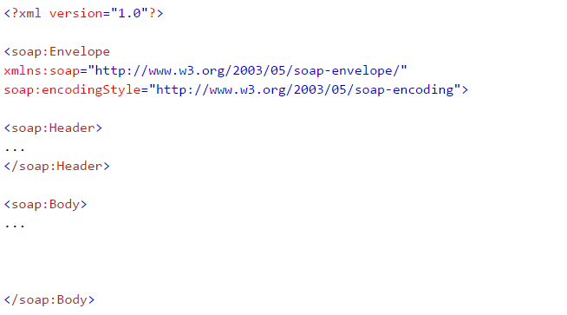
2.1.2: SOAP SOAP Building Blocks
Basic SOAP consists of Envelope, Header and Body:
Notes:
A SOAP message is an ordinary XML document containing the following elements:
An Envelope element that identifies the XML document as a SOAP message
A Header element that contains header information
A Body element that contains call and response information
A few syntax rules…..
A SOAP message MUST be encoded using XML
A SOAP message MUST use the SOAP Envelope namespace
A SOAP message MUST use the SOAP Encoding namespace
A SOAP message must NOT contain a DTD reference
A SOAP message must NOT contain XML Processing Instructions
Slide describes regarding basic SOAP message format

Slide 11
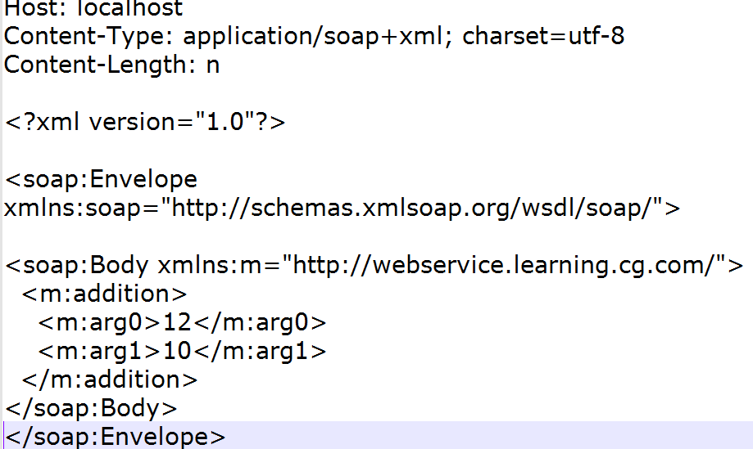
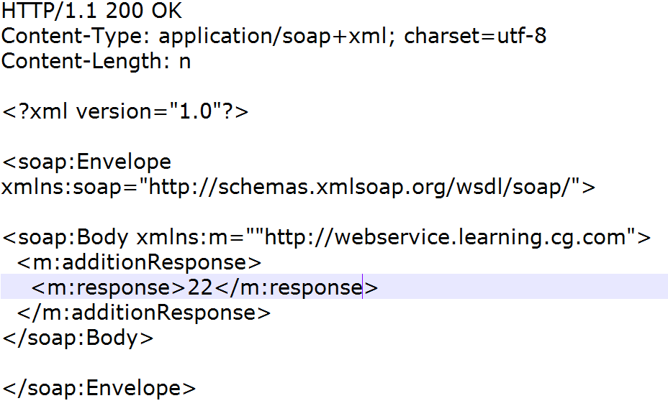
2.1.2: SOAP SOAP Request and Response
Following demonstrates a SOAP request
Following demonstrates a SOAP response
Notes:
In the example above, an addition request is sent to a server. The request has 2 parameters as number1 and number2 and addition of 2 numbers is returned in the response. The namespace for the function is defined in "http://webservice.learning.cg.com/".
Slide describes what typically is a SOAP request / response structure

Slide 12
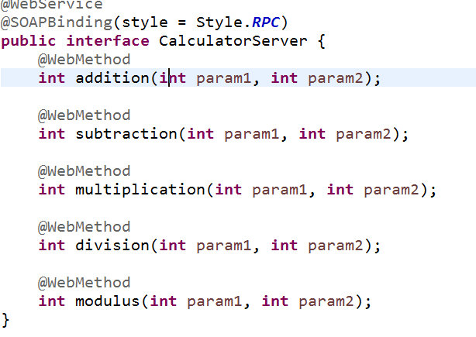
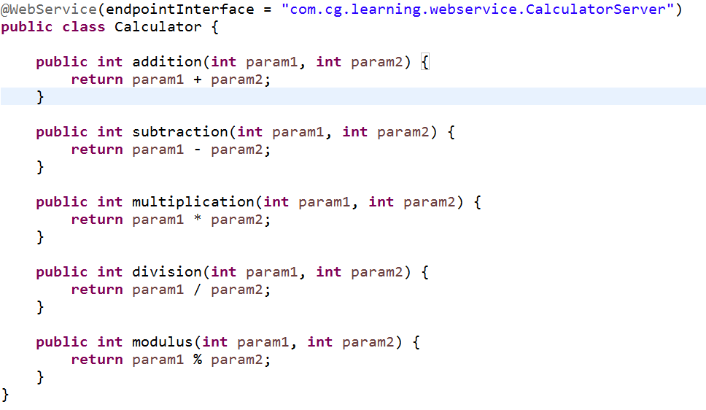
2.2: Creating Service Creating JAX- WS Service
End Point Interface
Implementation class
Notes:
The starting point for developing a JAX-WS web service is a Java class annotated with the javax.jws.WebService annotation.
The WebService annotation defines the class as a web service endpoint. SOAP binding style is given as RPC.
A service endpoint interface (SEI) is a Java interface that declares the methods that a client can invoke on the service
The web service implementation class implicitly defines a SEI.
You may specify an explicit SEI by adding the endpointInterface element to the WebService annotation in the implementation class.
You must then provide a SEI that defines the public methods made available in the endpoint implementation class.
Slide demonstrates to create a web service.
Refer demo: JAX– WS -Calculator

Slide 13
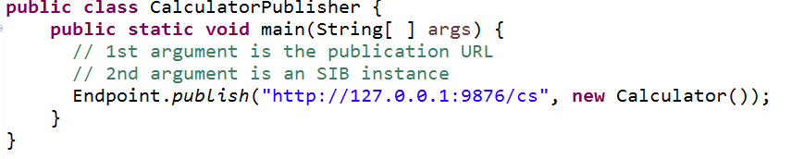
2.2: Creating Service Creating JAX – WS Service
The web service needs to be published so that it can await service requests
Refer below screen shot for same
Notes:
Currently the service is published at network address 127.0.0.1.which is localhost, and at port number 9876,
The application path /cs is an arbitary name.
The Endpoint class has an overloaded publish method. In this two-argument version, the first argument is the publication URL as a string and the second argument is an instance of the service SIB, in this case com.cg.learning.Calculator.
The application runs indefinitely, awaiting service requests.
It needs to be terminated at the command prompt with control-C or the equivalent.
You can check the following URL in browser:
http://127.0.0.1:9876/cs?wsdl
To view the service contract, the WSDL document.
Slide demonstrates regarding a publisher to publish a web service

Slide 14
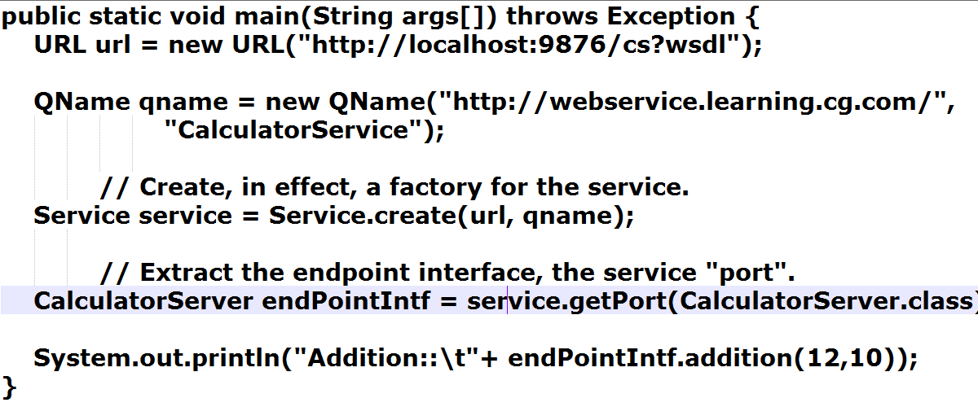
2.3: Consuming a Service Consuming JAX – WS Service
Refer below screen shot to consume a service:
Notes:
Here basic XML API is being used to consume a service.
The URL defines the location of wsdl document.
The Qname (qualified name) prints the service URI (as to where the service will be available). “CalculatorService” is the service name to be exposed in wsdl document.
Next we create a factory for the service with the URL and Qname at a port number where SEI (Service Endpoint Interface) is available.
Lastly by using endPoint interface we can consume the service.
Slide demonstrates regarding the consumption of a web service

Slide 15
2.3: Consuming a Service Demo
JAX-WS-Calculator
Notes:
Add the notes here.
Demo code to be used

Slide 16
Summary
We have so far learnt
What are JAX-WS
What are wsdl documents and their representation
What are soap messages and their request and response structure
How to create a JAX – WS service
How to consume a JAX – WS service
Notes:
Add the notes here.
Summary of the lesson.

Slide 17
Working with JAX-WS Lab
Lab 1
Notes:
Add the notes here.
Corresponding lab assignment

Slide 18
Review Question
Question 1: What gives information about the web service location and operation?
SOAP message structure
WSDL document
Service End Point interface
Question 2: @WebMethod signals that each method is a service operation (True or False)
True
False
Question 3:___________ is used to define protocol and data format?
Message
Port type
Binding
Notes:
Add the notes here.
Question 1: WSDL document
Question 2: True
Question 3: Binding

